Slide 1

VOICE AIDED TEXT PROCESSING FOR BLIND PEOPLE
Done by:
B. Yaswanth (20331A0527)
D. Partha Sai (20331A0545)
G.V.S. Ravi Kiran Varma (20331A0554)
B. Eswari Sai (21335A0501)

Slide 2
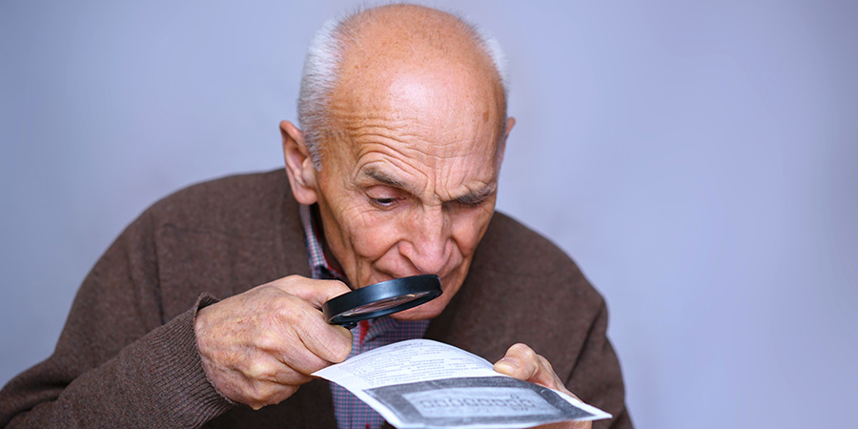
Introduction
There are many people who are suffering from visually impaired or blindness, these people face a lot of difficulties in their day-to-day activities.
The most difficult task for them is moving in an unfamiliar world of which they have no idea what is around them. Generally, people rely on their visions to familiarize with nearby surroundings around them.
With this project people who are visually impaired or blind can learn and study the text freely around the real time environment without any support as they will be get all the information about the content around him through voice mode.

Slide 3
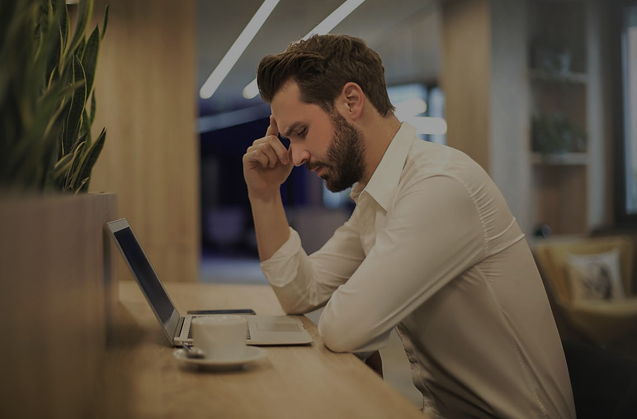
Problem Statement
Blind people have a tough time finding good reading materials in accessible formats. Millions of people in India are blind but we do not have even the proper textbooks in braille, leave alone the novels and other leisure reading materials.
Even though a blind person can use screen reading software but it does not make the Internet surfing experience very smooth if the websites are not designed accordingly.
Blind person depends on the image description for understanding whatever is represented through pictures. But most of the time, websites do not provide clear image description.

Slide 4
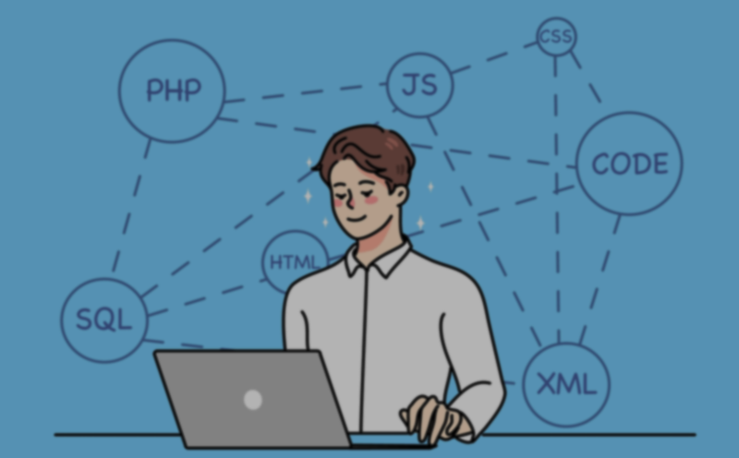
Abstract
In this project, Machine learning techniques are applied in order to help blind people by detecting the text in front of the person.
In this project images are detected with the help of a device and result is passed to the user in voice mode. In this Application user can also perform certain actions like send text message by converting the text to speech.

Slide 5
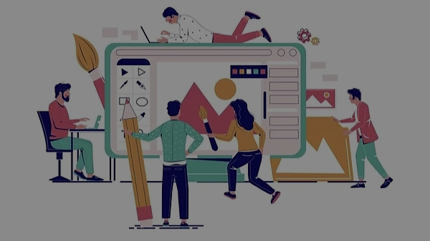
Objectives
A screen reader is an essential piece of software for a blind or visually impaired person so they can easily read without any need of learning braille.
The objective mainly focuses in fulfilling the need of visually impaired people in reading and browsing text from hand-held objects like books, documents etc., by implementing a camera-based text reading framework
To convert the captured image and give the response with at most accuracy.
And also embed the software into a device with minimal cost or a mobile application that work on voice assistant.

Slide 6
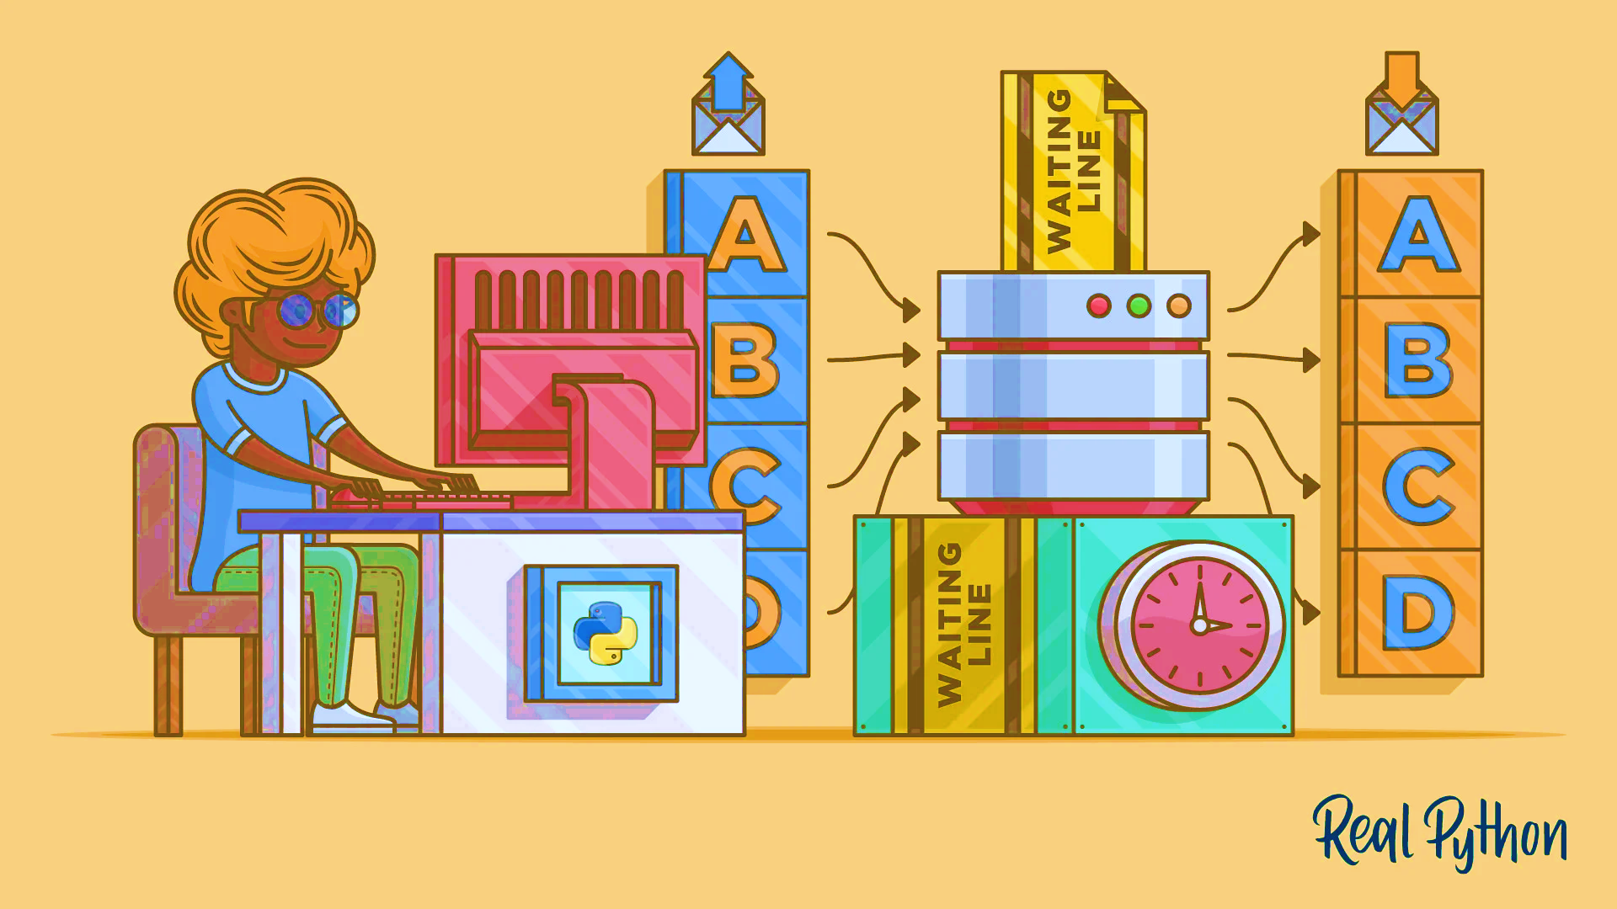
METHODOLOGY
We used pytessesract to get the text from the captured image. This module can scan any type of images like .jpeg, .png, .gif….etc.
To convert this captured text into voice, we used google text to speech and speech recognition modules to get voice and save the file.
For translating the text we used the googletrans module to convert the into any language the user want, we this module as it contains numerous languages.
And finally we used pyttsx3, pyaudio and pillow to listen the generated output.

Slide 7
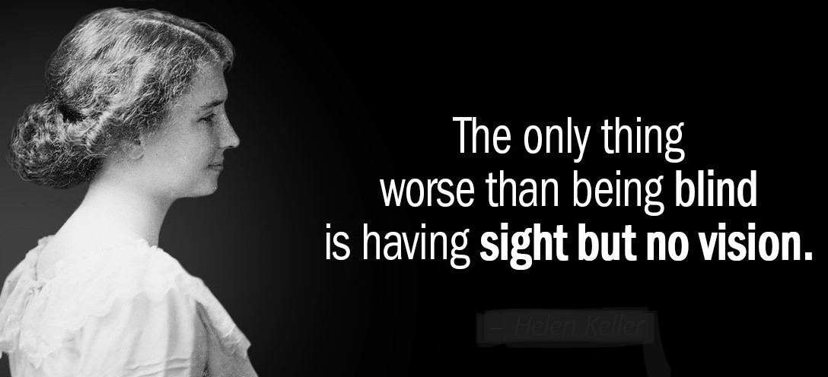
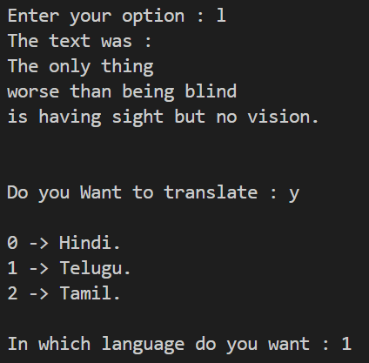
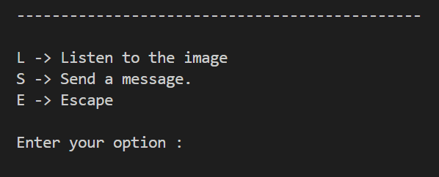

INPUTS
OUTPUTS

Slide 8

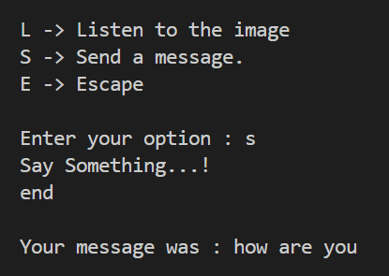
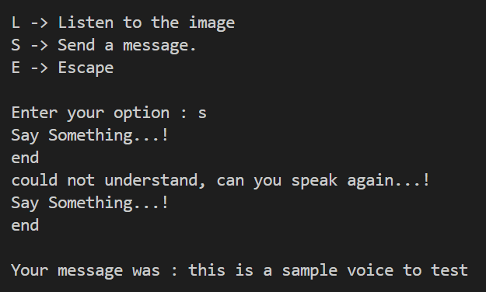

Slide 9
LIMITATIONS
There comes little latency because the voice command is passed after all those detections, classification, distance calculation and finding the object which is closer to the user. so, this shows little latency.
To use the google assistant we need 24/7 internet connectivity and minimal battery supply to run in any conditions.
This application does not work at night because of visibility issues of the object. These all issues will work out as the technology is evolving at a very fast rate. so, a system with a good processor will cover all these limitations.

Slide 10
PROJECT OUTCOME
From this project, we have learnt that how can we identify the problem from our surroundings and how can we help in tackling and giving a solution to this day-to-day problem using technology.
The proposed system discussed here will be easy for visually impaired or bind people to carry around. This system will assist the user to learn and read without anybody’s help, also reply textually, or send a voice reply.
This system will help them to communicate and read from surroundings. Using this application blind people interact with others and express their feelings.

Slide 11
CONCLUSION
There are many systems which are already developed which can give better results but they are very hard to carry out in normal day to day life. Even they are not feasible and more expensive.
From this project, we have learnt a new module in python like pytesseract, pyttsx3, gTTS, speechrecognition, pyaudio and googletrans frameworks which is used to implement complicated machine learning algorithm’s using python.
We can use this device not only for blind but also for the aged person as they lose their vision with age.
Finally, this project helped us to pave the path learning new skills, helped us to think out of the box, improve our thoughts towards society.

Slide 12
Thank You

